Slide 1
EMOTION DETECTION IN TEXT

Slide 2
ABSTRACT
In social media article, humans can understand the emotion of text by reading the comments, but computers cannot understand the emotion of text.
Sentiment Analysis is the analysis of the feelings (i.e. emotions, attitudes, opinions, thoughts, etc.) behind the words by making use of Natural Language Processing (NLP) tools and Deep learning technique.I am going to use LSTM and Nested LSTM to classify 6 emotions such as anger , fear, joy,love, sadness and surprise.

Slide 3
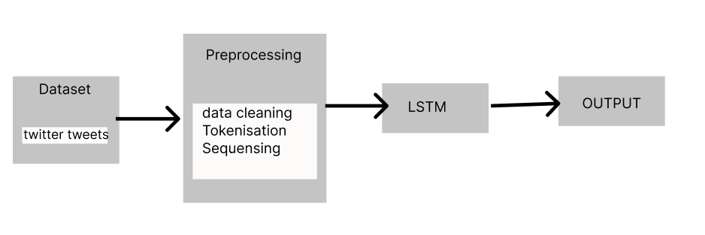
Archtecture diagram

Slide 4
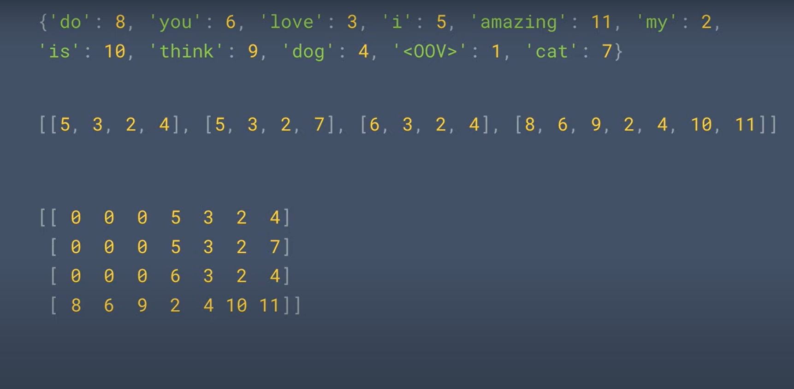
Tokenization , Sequensing

Slide 5
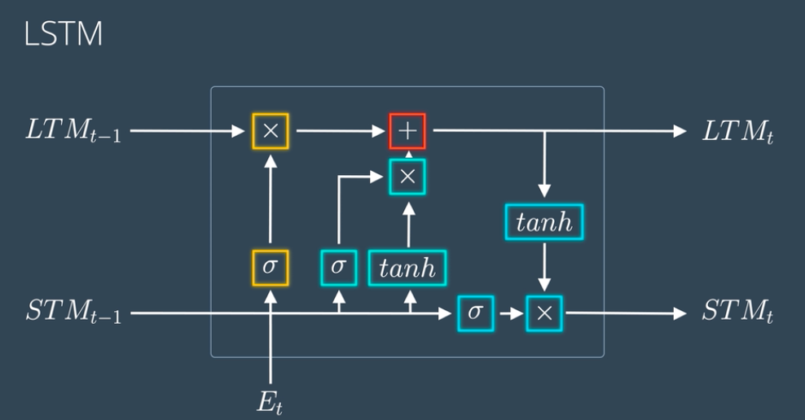
LSTM

Slide 6
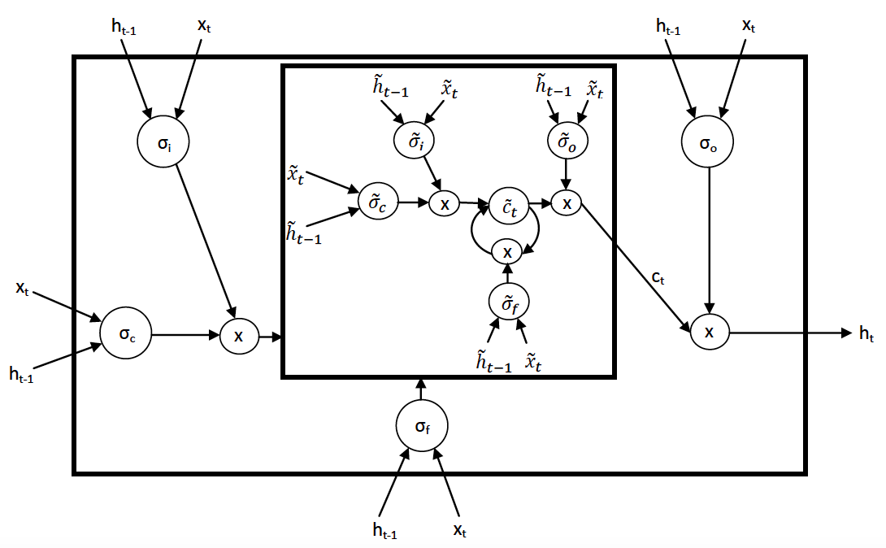
nlstm architecture

Slide 7
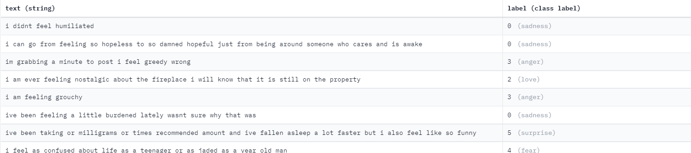
DATASET
dataset with 1.6 million tweets from kaggle.com
sample:
text: the text of the tweet
lable:love, sadness , fear , surprise,happy.

Slide 8
Reference
[1] Text Emotion Detection Based on Bi- LSTM Network,Academic Journal of Computing & Information Science ,ISSN 2616-5775 Vol. 3, Issue 3: 129-137, DOI: 10.25236/AJCIS.2020.030314.
[2] LSTM-based Text Emotion Recognition Using Semantic and Emotional Word Vectors ,2018 First Asian Conference on Affective Computing and Intelligent Interaction (ACII Asia)
[3]Emotion Detection in Text using Nested Long Short-Term Memory

